Slide 1
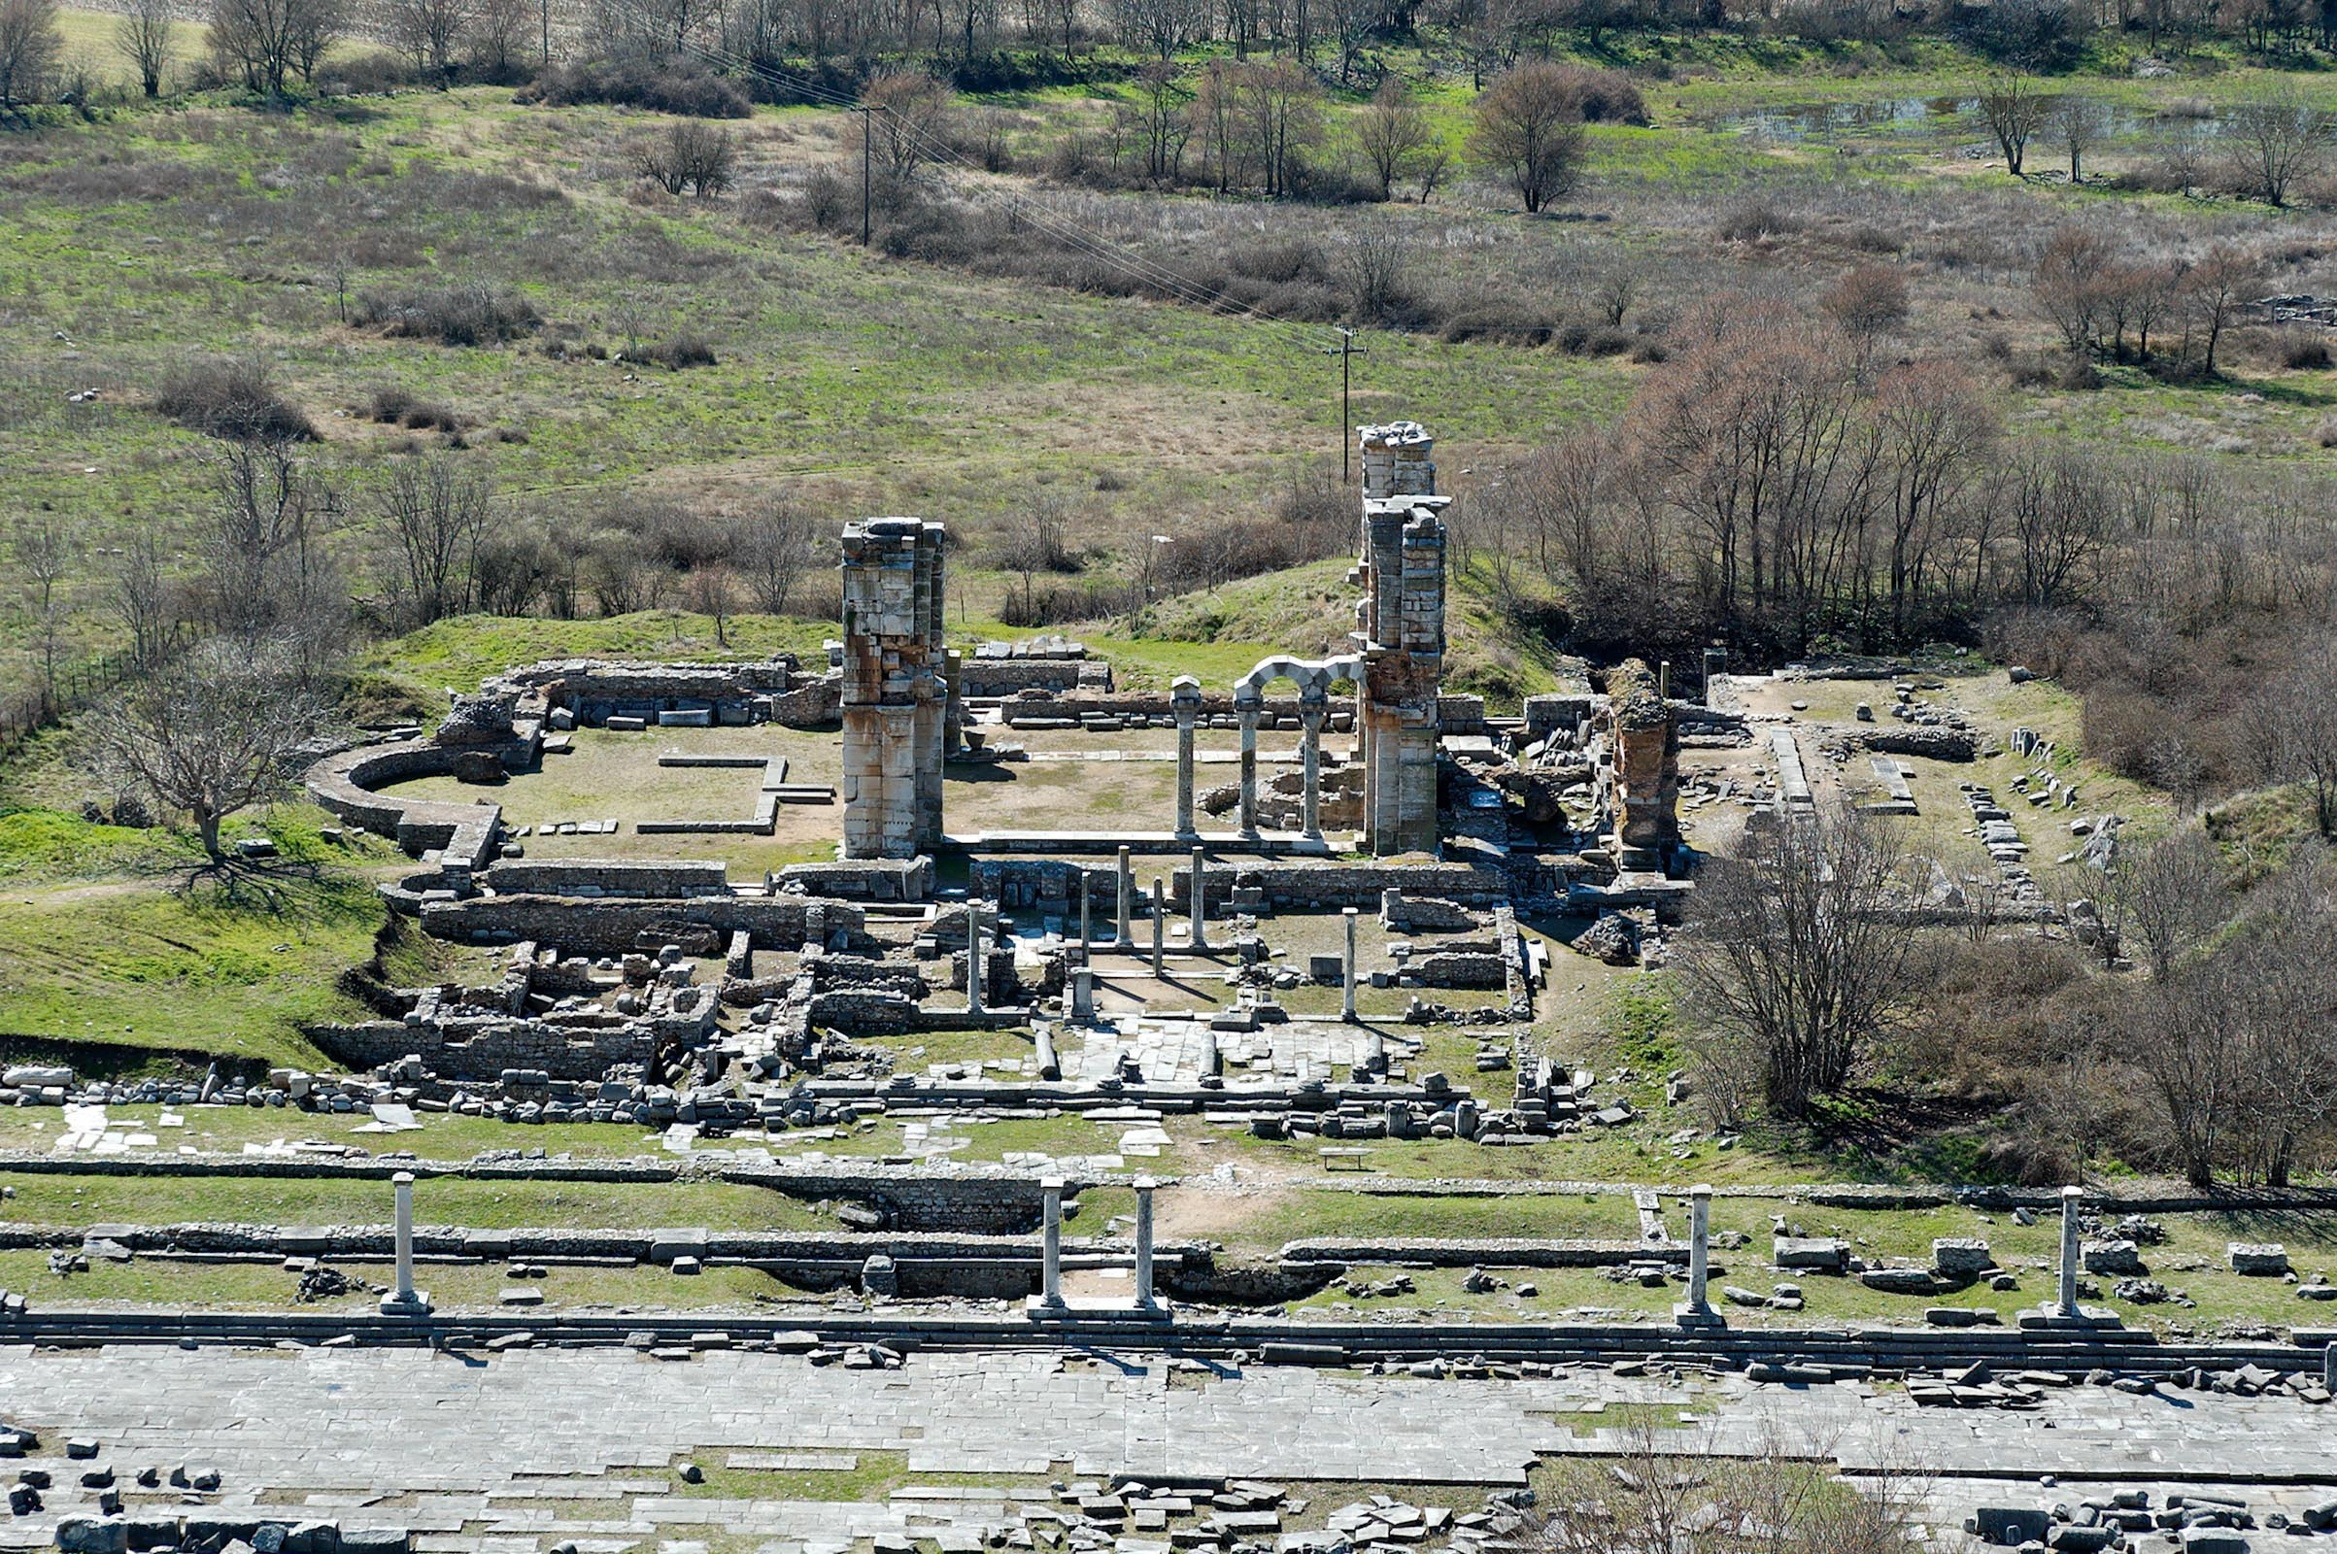
Philippians 1.3-8
Remains of market area and church in Philippi
image ©2012 Todd Bolen / BiblePlaces.com

Slide 2
Philippians 1.3-8 NET: I thank my God every time I remember you. I always pray with joy in my every prayer for all of you because of your participation in the gospel from the first day until now. For I am sure of this very thing, that the one who began a good work in you will perfect it until the day of Christ Jesus. For it is right for me to think this about all of you, because I have you in my heart, since both in my imprisonment and in the defense and confirmation of the gospel all of you became partners in God's grace together with me. For God is my witness that I long for all of you with the affection of Christ Jesus.

Slide 3
…I have you in my heart, since both in my imprisonment and in the defense and confirmation of the gospel all of you became partners in God's grace together with me...

Slide 4
Cultic Gospel Christ’s Gospel
earn righteousness accounted righteousness
by obedience of Christ by grace
earn salvation by given salvation by grace
becoming good through faith in Christ

Slide 5
Philippians 1.3-8 NET: I thank my God every time I remember you. I always pray with joy in my every prayer for all of you because of your participation in the gospel from the first day until now. For I am sure of this very thing, that the one who began a good work in you will perfect it until the day of Christ Jesus. For it is right for me to think this about all of you, because I have you in my heart, since both in my imprisonment and in the defense and confirmation of the gospel all of you became partners in God's grace together with me. For God is my witness that I long for all of you with the affection of Christ Jesus.

Slide 6
NET: I thank my God every time I remember you. I always pray with joy in my every prayer for all of you…
WBG: I give thanks to my God at every remembrance of you, always – in every prayer of mine in behalf of all of you – with joy making entreaty…
δέησις = an urgent prayer request
to meet a need

Slide 7
NET: I thank my God every time I remember you.
I always pray with joy in my every prayer for all of you…

Slide 8
I give thanks and joyfully pray for you
about your participation in the gospel from the start until now
because I know God will complete that work in you
until Christ returns
which is right for me, since I love you
and you are my partners in grace for suffering
to confirm and defend the true gospel.

Slide 9
Philippians 1.4-5 NET: I always pray with joy in my every prayer for all of you because of your participation in the gospel from the first day until now.
κοινωνία usually means “fellowship.”

Slide 10
Philippians 1.4-7 NET: I always pray with joy in my every prayer for all of you because of your participation in the gospel from the first day until now… it is right for me to think this about all of you, because I have you in my heart, since both in my imprisonment and in the defense and confirmation of the gospel all of you became partners in God's grace together with me.
συγκοινωνός = partner

Slide 11
Philippians 1.4-7 NET: …your participation in the gospel … all of you became partners in God's grace together with me.
They supported Paul’s mission:
ongoing prayer support [1.19]
financial support [4.10-18]
one of their leaders going to help [2.25-30]

Slide 12
Philippians 1.4-7 NET: …your participation in the gospel … all of you became partners in God's grace together with me.
They pursued the gospel mission:
suffering for their faith [1.27-30]
living as God’s witnesses [2.15-16]
defending and confirming the true gospel [1.7]

Slide 13
I thank my God every time I remember you. I always pray with joy in my every prayer for all of you …
For I am sure of this very thing, that the one who began a good work in you will perfect it until the day of Christ Jesus.

Slide 14
Philippians 1.6 NET: For I am sure of this very thing, that the one who began a good work in you will perfect it until the day of Christ Jesus.

Slide 15
I give thanks and joyfully pray for you
about your participation in the gospel from the start until now
because I know God will complete that work in you
until Christ returns
which is right for me, since I love you
and you are my partners in grace for suffering
to confirm and defend the true gospel.

Slide 16
    Philippians 1.3-8 NET: I thank my God every time I remember you. I always pray with joy in my every prayer for all of you because of your participation in the gospel from the first day until now. For I am sure of this very thing, that the one who began a good work in you will perfect it until the day of Christ Jesus. For it is right for me to think this about all of you, because I have you in my heart, since both in my imprisonment and in the defense and confirmation of the gospel all of you became partners in God's grace together with me. For God is my witness that I long for all of you with the affection of Christ Jesus.

Slide 17
true salvation through the gospel
grow spiritually
remain in the true church
pursue the gospel mission
align with Paul

Slide 18
I give thanks and joyfully pray for you
about your participation in the gospel from the start until now
because I know God will complete that work in you
until Christ returns
which is right for me, since I love you
and you are my partners in grace for suffering
to confirm and defend the true gospel.

Slide 19
Philippians 1.3-8
Remains of market area and church in Philippi
image ©2012 Todd Bolen / BiblePlaces.com

